Slide 1






















Home
Faculty of Computers and Information Technology (FCIT)
Project Title: Auto Attendance
Supervisor: Dr Mohammad Naif Al-Atawi
Student :
Mazen Mohsen Tohari
Abdulrhman Saeed Alshahrani
Ahmed Marzuq Alanzy
Thamer Thib Alanazi
Abdulmohsen Mohammed Alblawi
Rayed Alzahrani
Academic Year: 2022/23

Slide 2

Table Of Contacts
Outline
Home.
Outline.
Introduction.
Project Objectives.
Related Works.
Methodology.
Analysis.
ERD.
Conclusion.
Questions.

Slide 3
Introduction

Slide 4


There is time lost in the lectures to take the student attendance,
so how to solve it?
Problem overview:
The college needs a way to facilitate the status of attendance and absence.
The teacher loses 5-10 min to take attendance.
Introduction

Slide 5
Objectives

Slide 6


Make full use of the lecture time
Project objectives:
Ease of taking attendance
Objectives
increased reliability

Slide 7
Related Works

Slide 8
1- Time Camp
Time Camp is a presence for employees and students but lacks many basic features
Related Works

Slide 9
2- Bonsai
Bonsai is a set of tools for employees to manage attendance.
Related Works

Slide 10
3- Odoo
This site has some points similar to our program, such as attendance
Management.
Related Works

Slide 11
Methodology

Slide 12
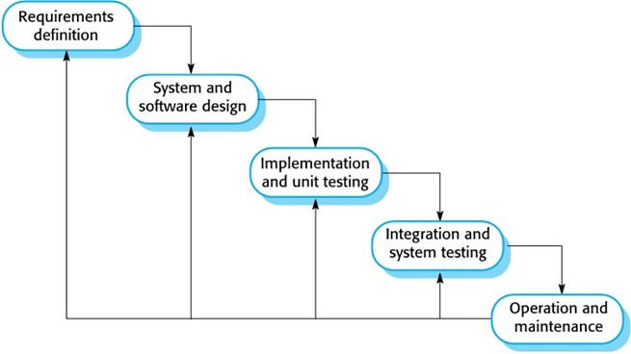
Methodology
Methodology
This project will use the waterfall methodology. The waterfall method is a project management approach that emphasizes a linear progression from the beginning to the end of a project.

Slide 13
Analysis and Design

Slide 14
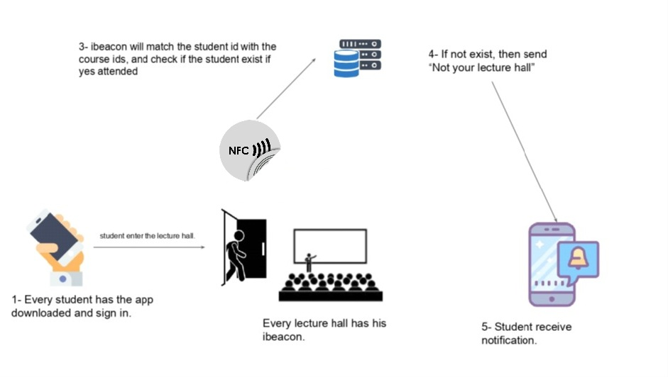
system architecture
Analysis
NFC
2-NFC will get the Signal
NFC

Slide 15
Requirements
A requirement is a constraint or a requirement that the system is obligated to meet. Software quality attributes are specified in these documents.
Analysis
Connecting the NFC to the system coding.
Connecting the NCF to the database.

Slide 16
Analysis and Design
UML

Slide 17
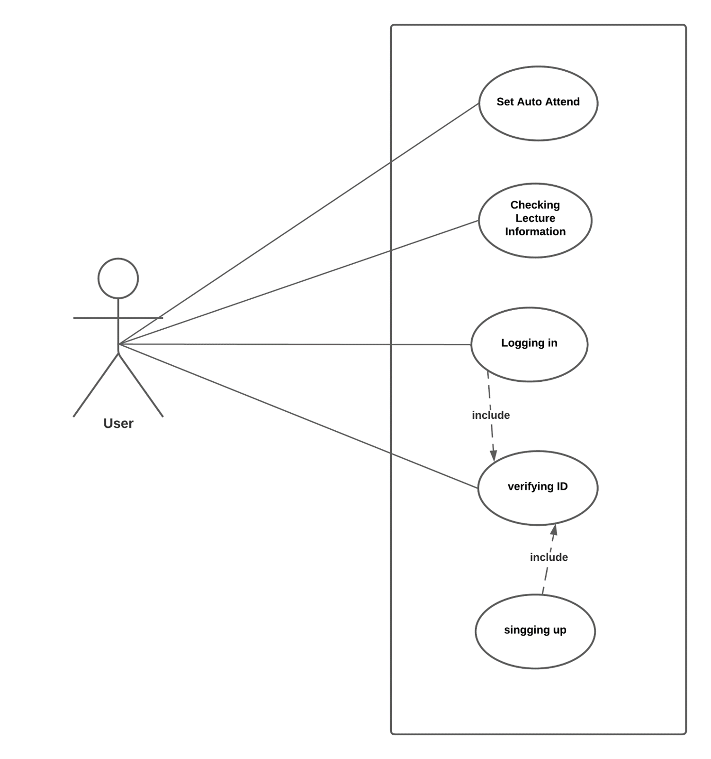
Analysis and Design

Slide 18
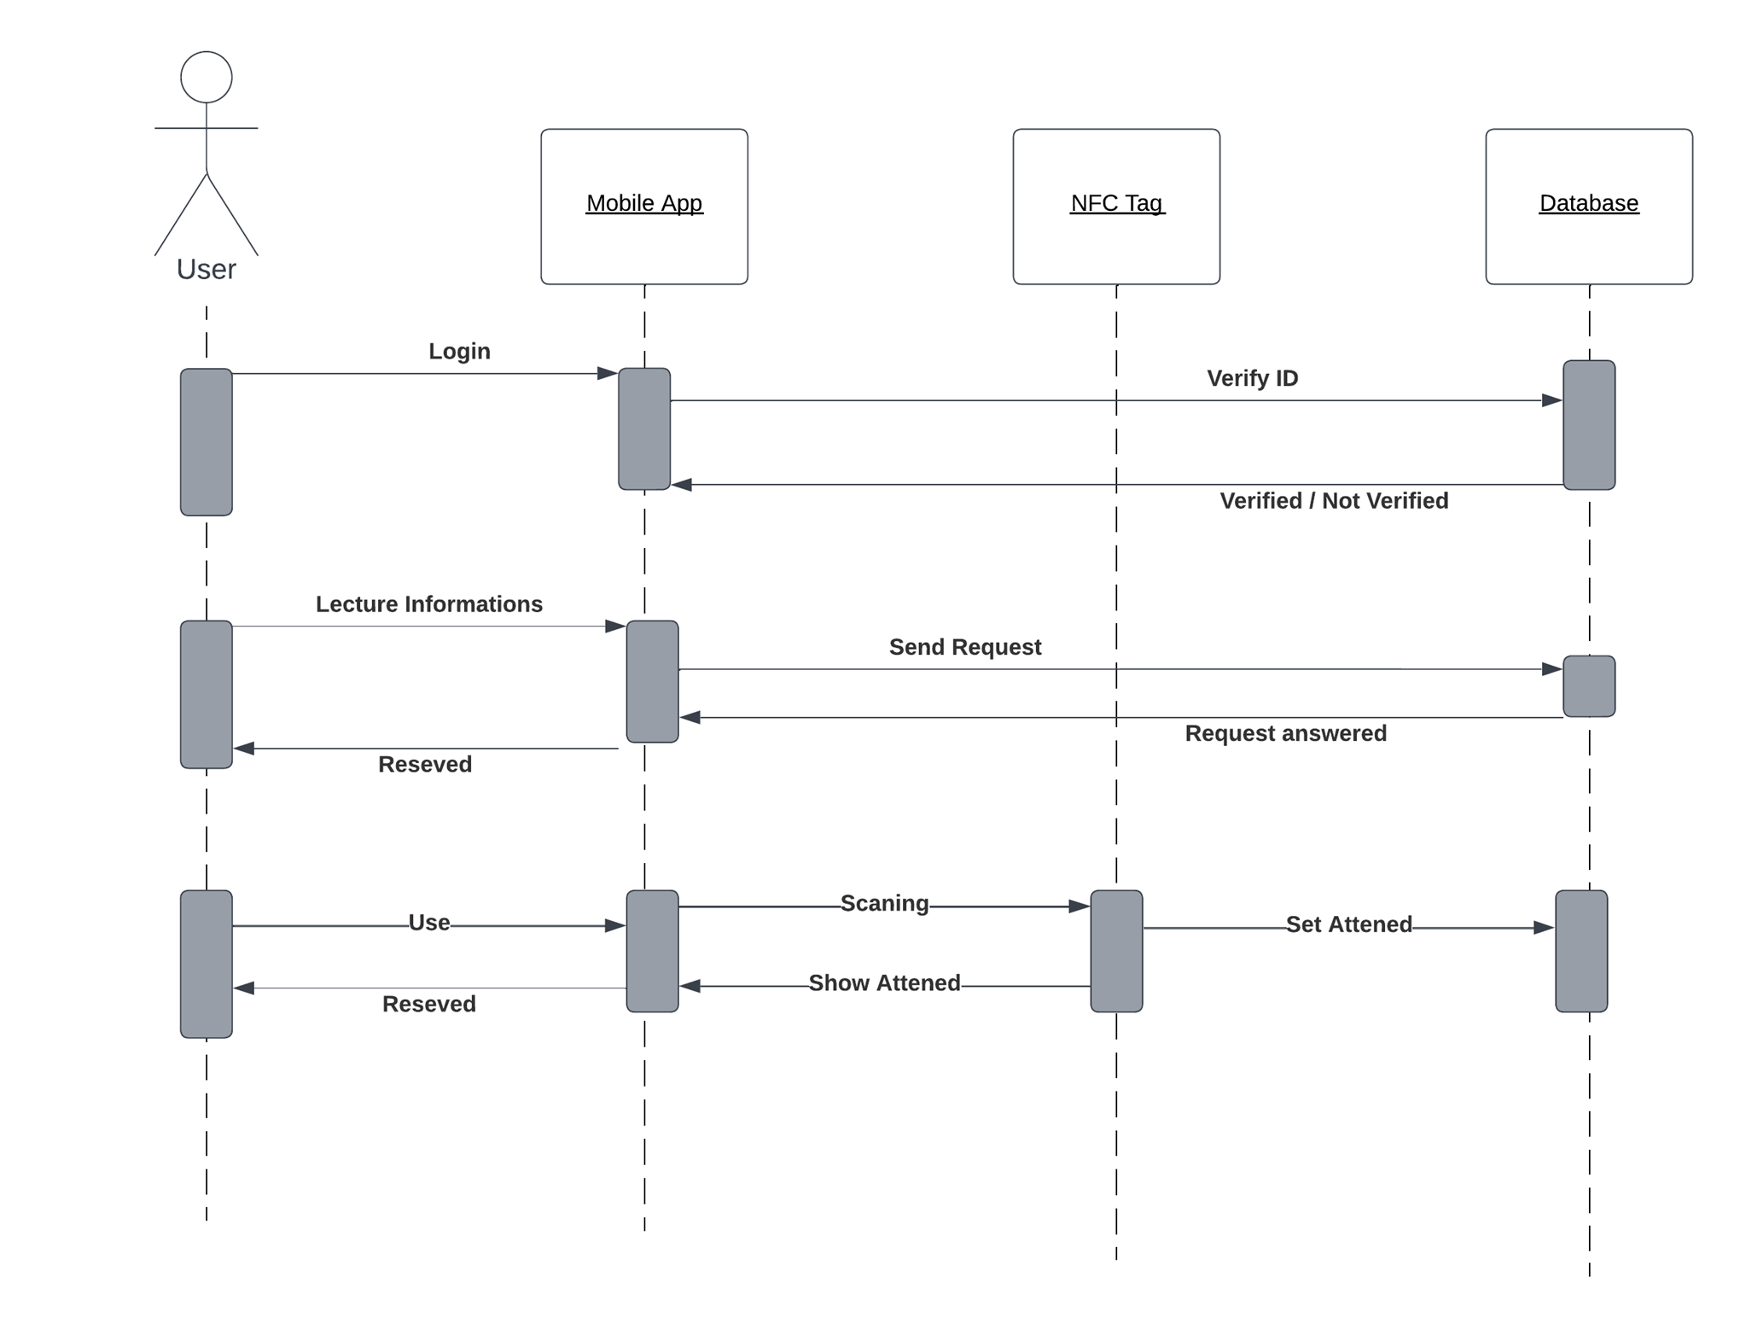
Analysis and Design

Slide 19
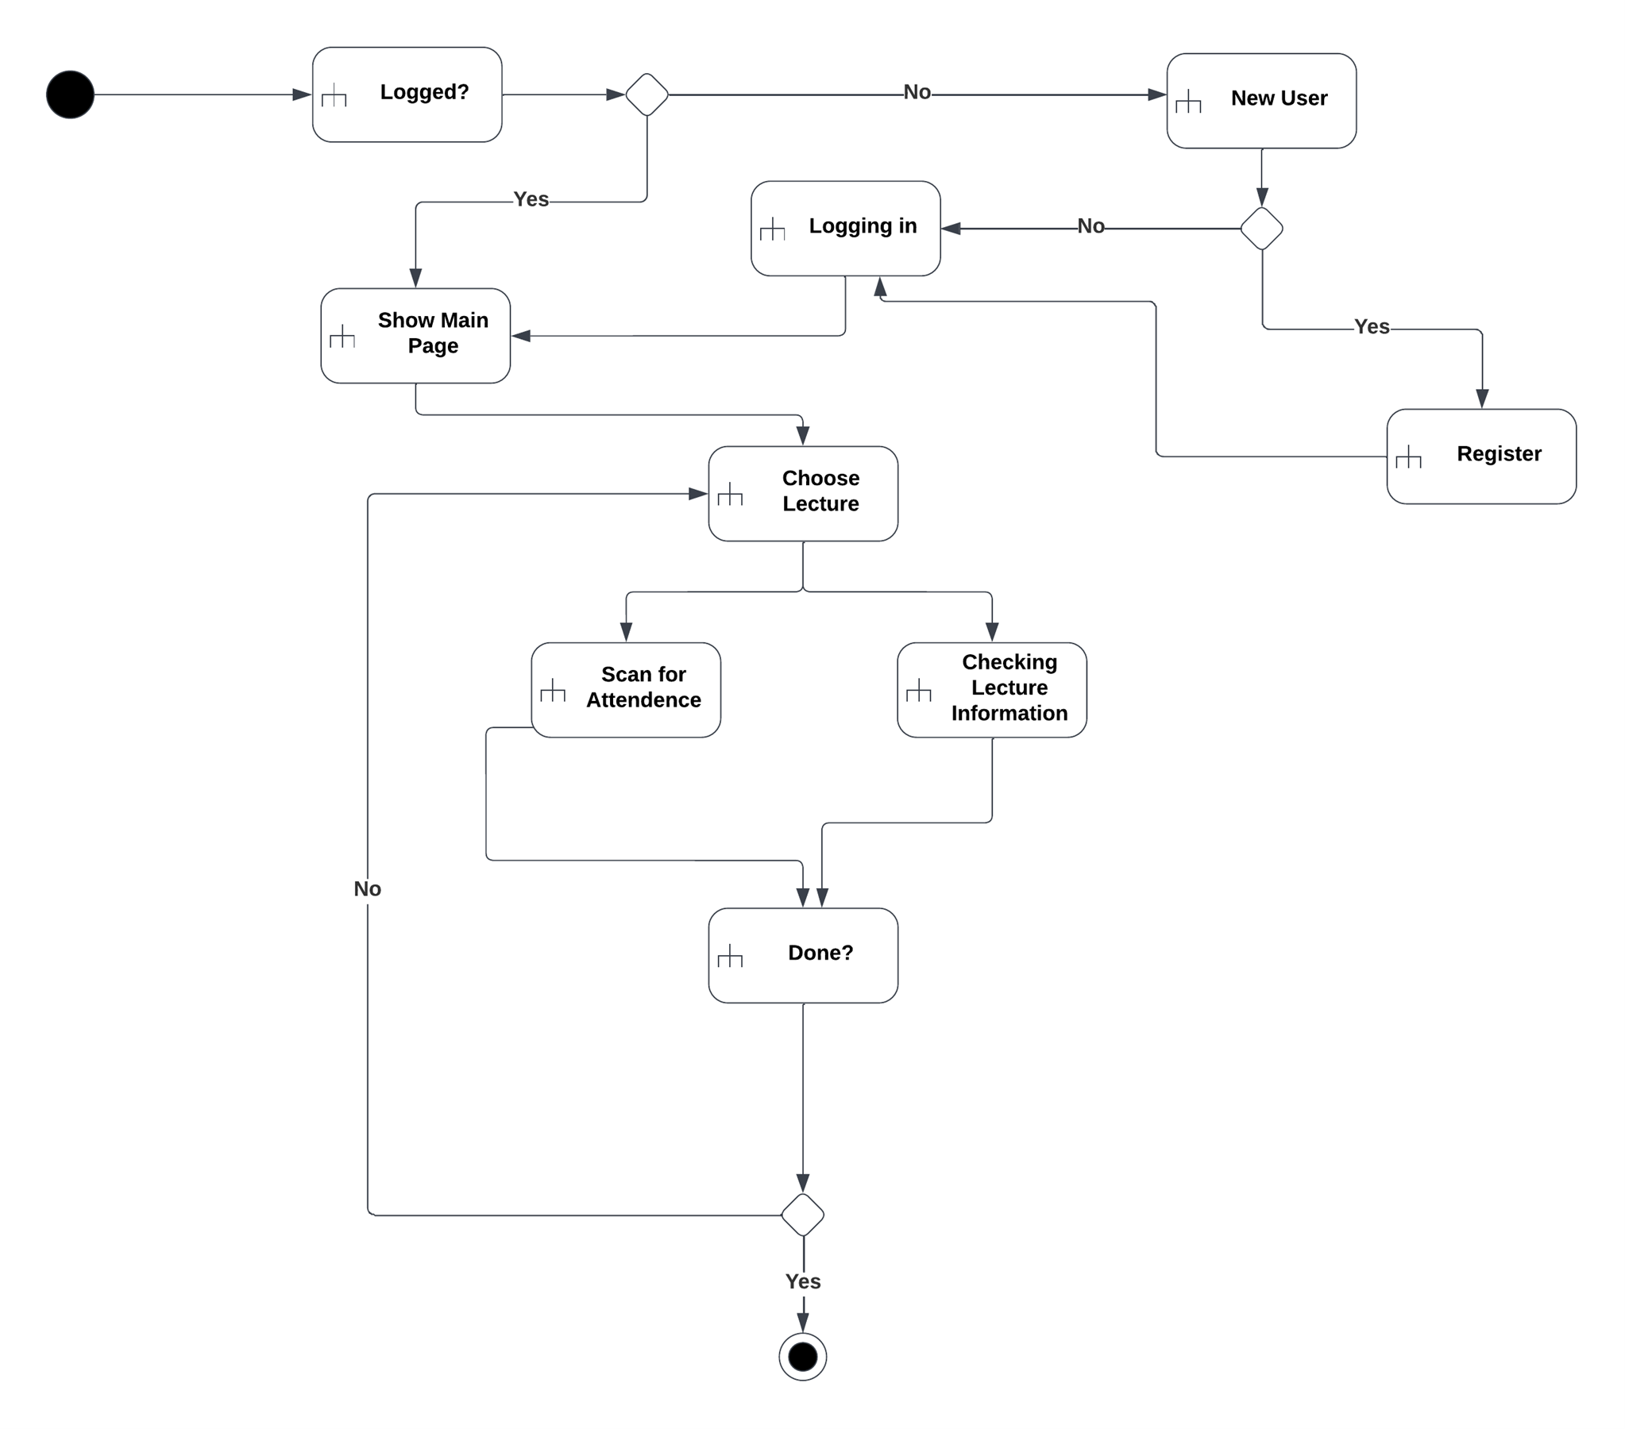
Analysis and Design

Slide 20

ERD

Slide 21
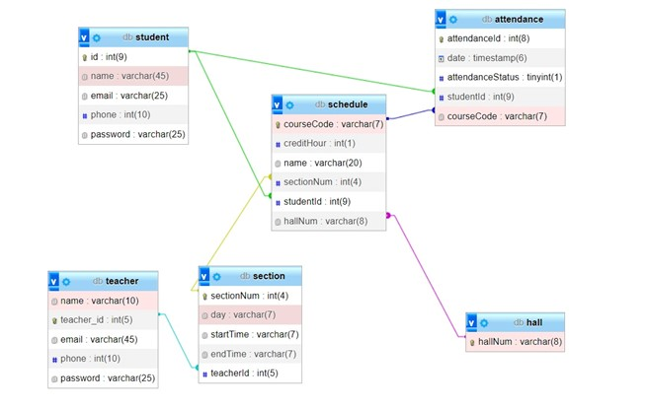
ERD

Slide 22
Conclusion

Slide 23
take the attendance, printing records things that may take time from the lecture or hard to do so we make it little bit easier.
Conclusion

Slide 24
Thank You
Any Questions?
Questions?

